Slide 1
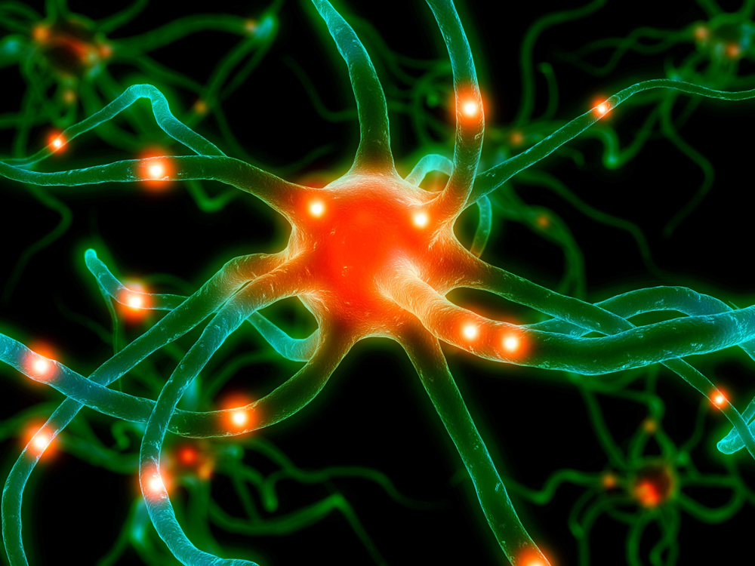
To tPA or not to tPA?
Answers to the question
Mary McMullen RN BSN CEN
MSN 621
Alverno College
                Microsoft Clip Art

Slide 2

Special Instructions
The cursor must be over the text in the question boxes to have the answers open correctly

Slide 3
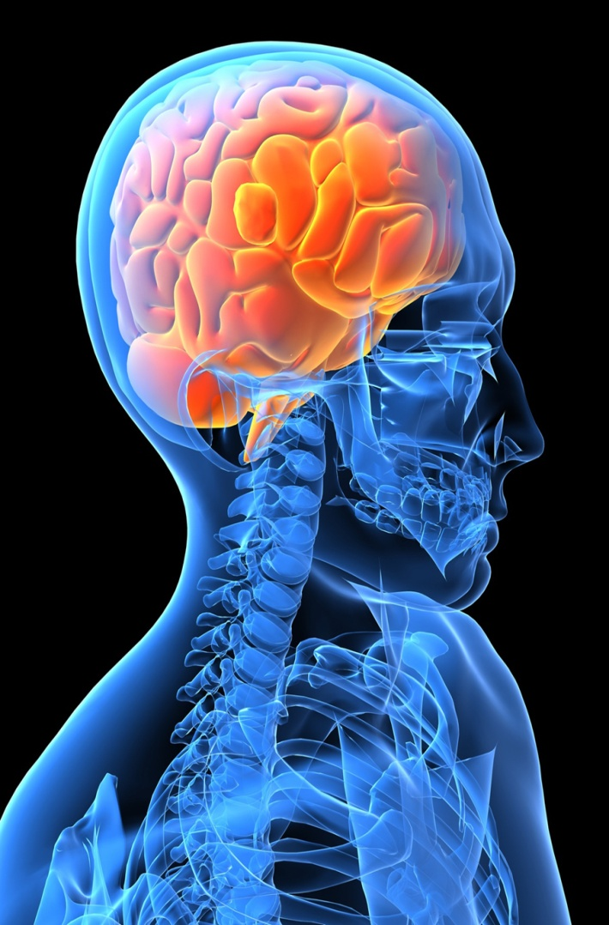
Fast Stroke Facts
The American Heart Association
reports:
Each year, 795 000 people experience
a new or recurrent stroke.
Mortality data from 2008, indicates that
stroke accounted For 1 of every 18
deaths in the United States.
On average, every 40 seconds,
someone in the United
States has a stroke.
Microsoft Clip Art

Slide 4
Case Study
You are working in a busy emergency department one Friday evening. You receive three patients within minutes of each other.
Mr. Ripley is a 63 year old black male with sudden onset of right sided weakness, difficulty speaking and dizziness. He has a history of hypertension and diabetes.
Ms. Watkins is a 37 year old female with new onset of right arm numbness, dizziness, headache and vision changes She is 2 weeks post partum. No other medical history
Mrs. Smith is an 80 year old Caucasian female with severe headache, vomiting and left sided paralysis. Her daughter states Mrs. Smith has a new onset of confusion and is now drifting in and out of consciousness.

Slide 5
Questions
What would you do?
        Microsoft Clip Art
Who would you treat first?
Microsoft Clip Art

Slide 6
Objectives
At the end of this module the learner will be able to:
List inclusion and exclusion criteria for patients receiving tPA for stroke
State three contraindications to the administration of tPA for stroke
State factors that affect appropriateness of tPA administration to patients with stroke symptoms
Identify potential complications from thrombolytic therapy

Slide 7
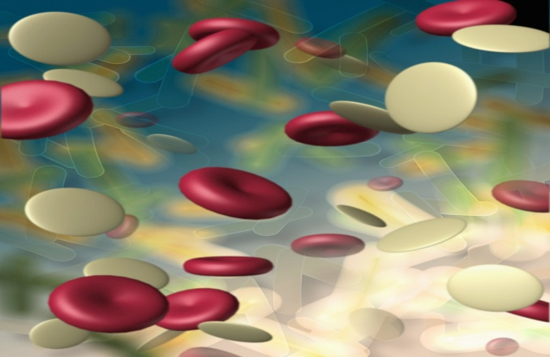
Facts about Tissue Plasminogen Activator (tPA)
In their article Thrombolytic Therapy in Emergency Medicine
published in Medscape, Rivera-Bou, Cabanas, and Villanueva (2011) describe naturally occurring Tissue plasminogen activator (tPA)as a fibrinolytic agent in our vascular endothelial cells which occurs to control clotting . It is naturally attracted to fibrin. When a thrombus [ blood clot] forms “The binding of tPA and plasminogen to the fibrin surface induces a conversion of plasminogen to plasmin and dissolving the clot.”
                tPA can be used to treat ischemic strokes. It is made by Recombinant DNA technology and acts on the clot as naturally formed tPA would.
IV tPA is the only medical therapy
approved by the U.S. FDA for the
treatment of ischemic stroke.
Porth, 2009
Microsoft Clip Art

Slide 8
Facts about Tissue Plasminogen Activator (tPA)
The time window for administration is within 3 hr of symptom onset. If patient wakes up with symptoms, symptom onset must be calculated from the time the patient fell asleep.
  Some new data suggest that IV TPA can be administered safely and with benefit in select patients up to 4.5 hours after symptom onset. There are additional exclusion criteria if IV TPA is given beyond the 3-hr window.
There are strict criteria for the administration of IV TPA .
(We will discuss these)
The protocol is weight based, with 90 mg being the maximum allowable dose.
The risk of brain hemorrhage with IV TPA is about 5% in stroke patients.
                Ferri, 2012

Slide 9
Assessment
More information is needed to determine if each patient is a candidate for tPA
Mr. Ripley’s wife states his symptoms started 30 minutes ago. She insisted they call an ambulance and get to the hospital.
Ms. Watkins states she has been having her symptoms intermittently since she delivered the baby 2 weeks ago. They became worse after she woke from a 2 hour nap, 4 hours ago.
Mrs. Smith’s daughter states her mother complained of a severe headache and started vomiting 30 minutes prior to admission. She became less responsive in the ambulance.

Slide 10
Question
Thinking of the time constraints, which patient(s) could be a candidate for tPA?
Mr. Ripley
Correct
Ms. Watkins
No, It has been too long since start of symptoms
Mrs. Smith
Correct

Slide 11
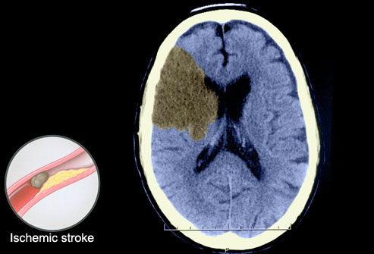
Criteria for considering TPA as a treatment option:
Noncontrast CT scan without
evidence of hemorrhage
Measurable deficit on stroke NIH stroke scale exam
Time since onset of symptoms is clearly <3 hr before TPA
administration would begin
Patient age 18 or older
Aldeen, 2009
Microsoft Clip Art

Slide 12
The NIH Stroke Scale
*The NIHSS is a 15-item neurologic examination stroke scale used to evaluate the effect of acute cerebral infarction on the levels of consciousness, language, neglect, visual-field loss, extra ocular movement, motor strength, ataxia, dysarthria, and sensory loss. A trained observer rates the patent’s ability to answer questions and perform activities. Ratings for each item are scored with 3 to 5 grades with 0 as normal, and there is an allowance for untestable items. The single patient assessment requires less than 10 minutes to complete.
                NIH Stroke Scale International (2010)

Slide 13
Criteria for considering TPA as a treatment option:
Noncontrast CT scan without
evidence of hemorrhage
Measurable deficit on stroke NIH stroke scale exam
Time since onset of symptoms is clearly <3 hr before TPA
administration would begin
Patient age 18 or older
Aldeen, 2009
Microsoft Clip Art

Slide 14
Case Study (con’t)
A Stat CT scan is ordered on Mr. Ripley and Mrs. Smith
Mr. Ripley’s report shows no acute changes
Mrs. Smith’s report shows a large subarachnoid hemorrhage
Who could still be considered for tPA?
Mrs. Smith
No tPA could cause further intracranial bleeding
Mr. Ripley
Correct
Notes:
You could explain why Mrs. Smith is no longer a candidate.

Slide 15
Criteria for excluding as a treatment option
(Click on each box)
Signs of Intracranial Bleeding
Loss of consciousness, Vomiting, Severe Headache, Seizure at stroke onset
High Risk of Bleeding
Arterial puncture within the past 7 days, Recent lumbar puncture, Stroke, Intracranial surgery, or head trauma within the previous 3 mo, Major surgery or serious trauma within the preceding 14 days, Evidence of intracranial hemorrhage, Known arteriovenous malformation or aneurysm
Active Bleeding
Active internal bleeding, GI or GU bleeding within the past 21 days

Slide 16
Criteria for excluding tPA as a treatment option
(Click on each box)
Bleeding Diatheses
Recent use of warfarin with an INR of ≥1.7, Use of heparin within 48 hrs with a prolonged aPTT, Platelet count of <100,000/mm³
Treat These Prior to Administering tPA
Systolic blood pressure >185 mm Hg or diastolic blood pressure >110 mm Hg that does not decrease below that range with treatment, Blood glucose <50 mg/dl or >400 mg/dl
Risk Outweighs Benefits
Rapidly improving neurologic signs, Isolated mild neurologic deficits, Patient who is pregnant or lactating, Acute MI

Slide 17
Question
Additional history and a physical examination is needed to determine if Mr. Ripley is a candidate for tPA.
It has now been an hour and 20 minutes since the onset of symptoms
His BP 170/112 P 72 irregular R 18 T 98.4
What lab results would you want to know?
Accucheck
Correct (to check for hypo or hyperglycemia )
PT/PTT
Right ! Elevated levels would indicate an increased bleeding risk
Platelet Count
You’ve Got It ! tPA is contraindicated if platelets < 100,000

Slide 18
Case Study (con’t)
What medical history would contraindicate the use of tPA for Mr. Ripley?
Controlled Hypertension
No
Diabetes
No, unless blood glucose < 50 mg/dl or >400 mg/dl
GI Bleed 2 weeks PTA
Yes!

Slide 19
Case Study (con’t)
What medication would you want to start PRIOR to beginning tPA on Mr. Ripley?
Proton Pump Inhibitor
May need this, but not first priority
Antihypertensive
Yes! BP Needs to be below 185/110
Sedative
Not Right Now

Slide 20
Case Study (con’t)
The neurologist writes the order to administer tPA.
You administer the correct dose and start to see improvement in his symptoms within the hour
What complications would you continue to watch for?
Bleeding
Yes!
Hyper or Hypotension
Yes !
Neurologic Deterioration
Yes

Slide 21
Acute Ischemic Stroke
THE TOTAL DOSE FOR TREATMENT OF ACUTE ISCHEMIC STROKE SHOULD NOT EXCEED 90 mg.
The recommended dose is 0.9 mg/kg (not to exceed 90 mg total dose) infused over
60 minutes with 10% of the total dose administered as an initial intravenous bolus over1 minute. © 2012 Genentech USA, Inc

Slide 22
Case Study (con’t)
The neurologist writes the order to administer tPA.
You administer the correct dose and start to see improvement in his symptoms within the hour
What complications would you continue to watch for?
Bleeding
Yes!
Hyper or Hypotension
Yes !
Neurologic Deterioration
Yes!

Slide 23
Outcome
Mr. Ripley is transferred to the Neuro intensive care unit and makes a quick recovery. Upon discharge he has only a mild deficit in his right hand.

Slide 24
Summary
You have learned:
Inclusion and exclusion criteria for the administration of tPA for stroke
Contraindications to the administration of tPA for stroke
Factors that affect appropriateness of tPA administration to patients with stroke symptoms
Potential complications from thrombolytic therapy

Slide 25
References
Activase for Acute Ischemic Stroke. Retrieved at: https://www.activase.com/home/index.jsp
Aldeen, A., Pirotte, M., (2009) Focus On: Acute Ischemic Stroke. Retrieved from
http://www.acep.org/Clinical---Practice-Management/Focus-On--Acute-Ischemic-Stroke/
American Heart Association Circulation . published online December 15, 2011 retrieved from
http://circ.ahajournals.org/content/early/2011/12/15/CIR.0b013e31823ac046.citation
Ferri, F. (2012) Ferri's Clinical Advisor 2012: FiveBooks in One , 1st ed. Philadelphia, PA : Copyright © 2011 Mosby, An Imprint of Elsevier
The Internet Stroke Center (2012) Stroke Statistics Retrieved from http://www.strokecenter.org/patients/about-stroke/stroke-statistics/
NIH Stroke Scale International (2010) Retrieved at: http://www.nihstrokescale.org/
Porth, C.M., Matfin, G., (2009). Pathophysiology: Concepts of altered health states. Philadelphia, PA. Lippincott
Rivera-Bou, W., Cabanas, J.G., Villanueva, S.E., ( Aug. 25,2011) Thrombolytic Therapy in Emergency Medicine Retrieved from:
  http://emedicine.medscape.com/article/811234-overview#a1

Slide 26
Case Study (con’t)
The neurologist writes the order to administer tPA.
You administer the correct dose and start to see improvement in his symptoms within the hour
What complications would you continue to watch for?
Bleeding
Hyper or Hypotension
Neurologic deterioration

